Slide 1
Data Science: Nuts & Bolts
Oct 2019

Slide 2
Agenda for the Discussion
Data is the Key
DS/ML/AI
A Typical
DS Project
Tools &
Technology
Q & A

Slide 3
Agenda for the Discussion
Data is the Key
DS/ML/AI
A Typical
DS Project
Tools &
Technology
Q & A

Slide 4
Data, types of Data and Data Sources
Data
Structured
Un-Structured
C1 | C2 | C3 | C4
A | 1 | 4 | 7
B | 2 | 5 | 8
C | 3 | 6 | 9
Text
Image
Audio
Video
Sources: Facebook posts, tweets, complaints, reviews, photos, recordings, phone-calls, blogs etc.
Sources: all the row-column, relational databases, txn data. Most common source of data

Slide 5
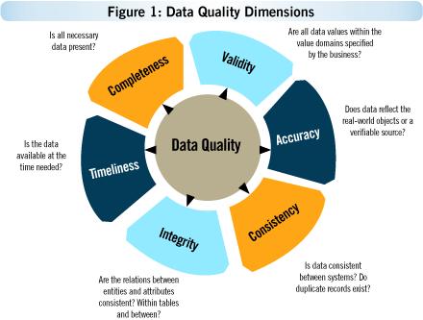
Data: Quantity & Quality is the key
Are all Data values within the domain specified by the business?
Is all necessary data present?
Does data reflect the real-world objects or a verifiable source?
Data Impacts the Results
Data Quality
% Missing Values
% Wrong Values
Historical Values
Is all the data required at the time needed?
Are the relations between entities & tables consistent?
Is Data Consistent between systems? Do duplicate records exist?
For making any meaningful claims and suggestion, data for at least last 4-5 cycles is required to uncover patterns, cyclicity , anomalies and behaviours.
There is no alternative to Data. Any claim made on 80% of available data might not be TRUE.
Garbage In → Garbage Out. Corresponding to the quality of data fed to the systems, we will the results.
The better the quality of data, more reliable are the results.
Image Source: Kovair

Slide 6
Examples of Good and Bad Data
DateTime | Value | TagName | Line | Zone
27/06/2019 | 4 | L56_Zone16.State | L56 | Z16
29/06/2019 | 4 | L56_Zone16.State | L56 | Z16
19/06/2019 | 4 | L52_Zone04.State | L52 | Z04
21/06/2019 | 4 | L51_Zone15.State | L51 | Z15
10/07/2019 | 4 | L56_Zone04.State | L56 | Z04
DateTime | Value | TagName | Line | Zone
27/06/2019 | 4 | L56_Zone16.State | L56 | Z16
XYZ | A |  | VV | 16
19/06/2019 | - | L52_Zone04.State | null | Four
$&^$_ | 4 | NULL | L51 | --
10/07/2019 | 4 | 0 | L56 | 0
Common Issues with the Data Quality
Missing Values or NULL Values
Duplicate Entries for the same row
Outliers are present in the data
Junk values are present in the data

Slide 7
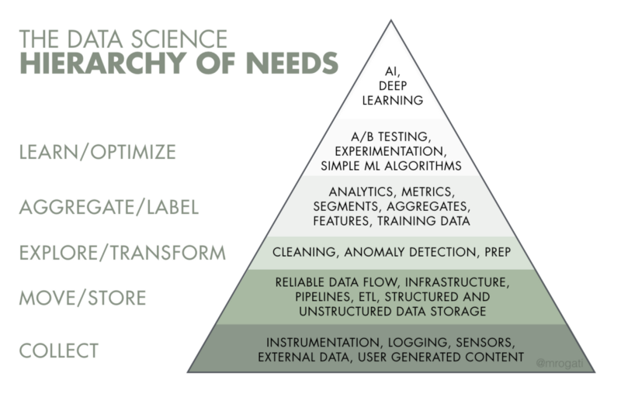
Importance of Data Engineering
Data Engineering is one of the core pillars for any Data Science project to succeed
In first step, Data sources have to be identified
All the sources (excel, csv, txt, tables etc.) have to be thoroughly scanned and understood
A Data Pipeline is created to ingest all the data into servers ready for use
Data Engineering ensures that we are able to aggregate all the data sources and it paves the way for further reporting/analysis
Without a Strong Data Engineering team, a Data Science project will surely suffer
Image Source: towardsdatascience

Slide 8
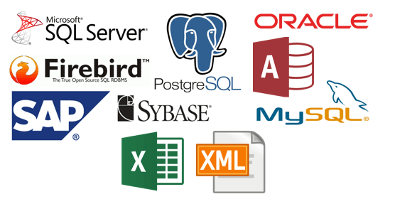
There are multiple Data Sources “always”…
And hence it pays to have a standard definition across the Data Sources.
Same variable name in different Data Sources can mean differently.
Image Source: clearbit

Slide 9
Agenda for the Discussion
Data is the Key
DS/ML/AI
A Typical
DS Project
Tools &
Technology
Q & A

Slide 10
Business Problem - Clear, concise, measurable & achievable
Increase the production
Decrease the cost
Increase the revenue by 80% in 1 month
Automate the entire process
Business Problem
Concise
Measurable
Achievable
Repeatable
Optimize the various cost heads (A,B, C and D) and identify the most optimal combination to decrease the cost by 1.2% in next 6 months
From the various factors of defects in the process (X,Y,Z), identify the most significant factors to reduce the defect % by 1.8% in next 3 months

Slide 11
What Data Science can do (and what it can’t)
Where DS can help
Assist in making decisions by analysing multi-dimensional data which is quite difficult for a Human Being
Use statistical tools & techniques to uncover patterns
The algorithms further help in measuring the accuracy of the patterns & the claims
The results are reproducible and can be improved
The Machine Learns which is a big difference from the traditional Software Engineering
Limitations of Data Science
Data is not an alternative to experience
Data Science cannot replace the Subject Matter Knowledge
Data Science depends on Data Availability and Data Quality. Depending on the input, we will get the output
Data Science will not increase the revenue or sales or output by 50% overnight. Similarly, it will not decrease the cost by 1/3 immediately
A Data Science project takes time to be implemented.
Notes:
DS cannot define the business problem (go in stages)

Slide 12
Data Science, AI, Machine Learning & Deep Learning
Automation Solutions
Machine Learning
Deep Learning
Artificial Intelligence
Data Science
Classic
Machine Learning
Neural Networks
Complexity is NOT proportional to accuracy. Rather than focus on Business Problem

Slide 13
Grouping of the Various Machine Learning Algos
Machine Learning
Supervised
Unsupervised
Semi-supervised
Then there are quite a few solutions like Market Basket Analysis, Recommendation Engines, PCA, SVD etc.
Regression
Classification
Algorithms generally used in Machine Learning:
Regression (Linear/Logistic)
Decision Tree
Random Forest
Gradient Boosting
Support Vector Machine
Neural Networks
Clustering
Market Basket Analysis
Recommendation Engine
Principal Component Analysis
Notes:
Business Problem to Data to the algorithms

Slide 14
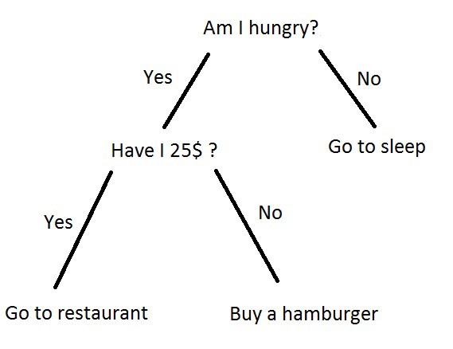
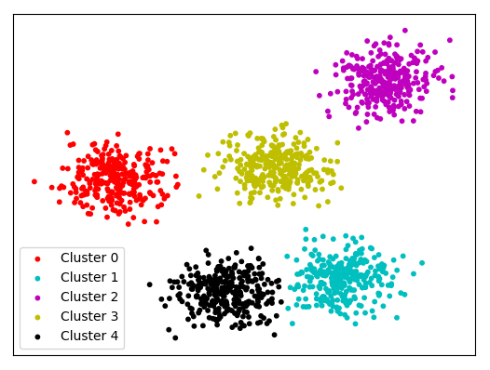
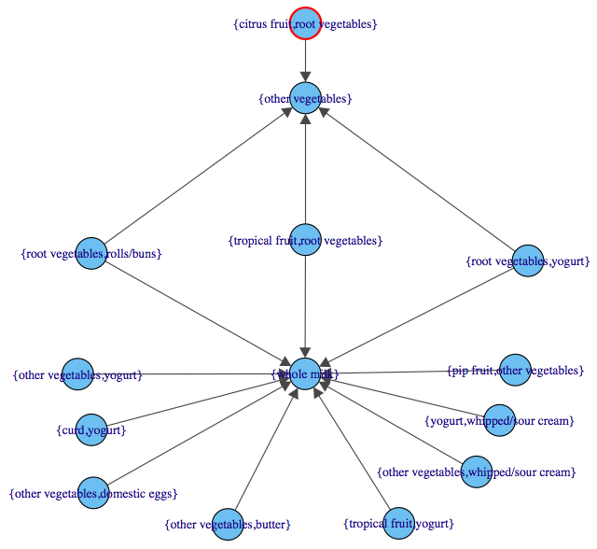
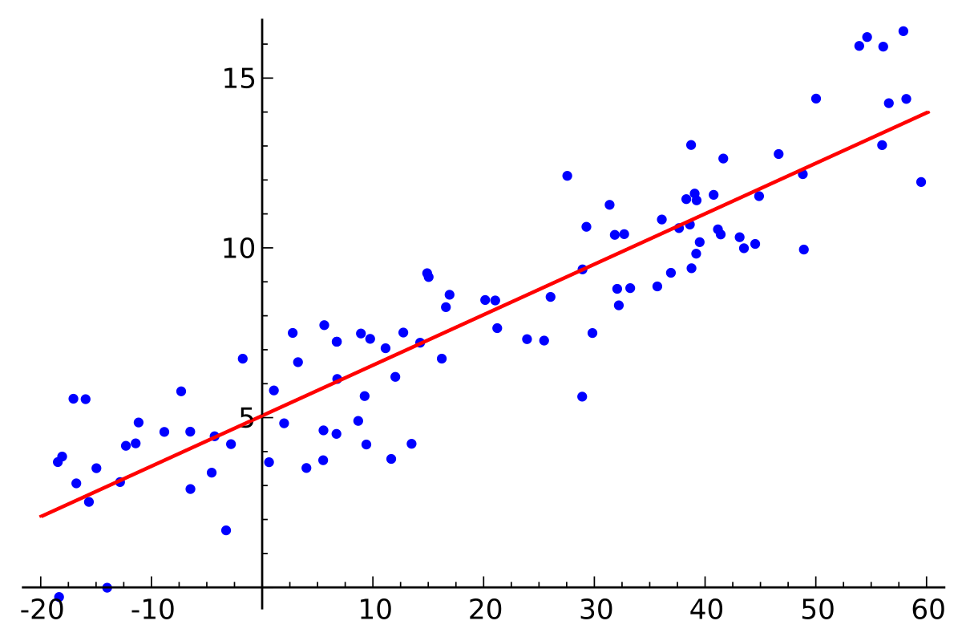
How an algorithm works in the background
Clustering
Decision Tree
Market Basket
Regression
Image Source: internet

Slide 15
Some Sample use cases for groups
Classification (e.g., spam or not spam, customer churning /not, event happening /not)
Recommendations (e.g., Amazon and Netflix recommendations for Next Best Product)
Clustering and Segmentation (e.g., demographic-based marketing)
Anomaly detection (e.g., fraud detection in Credit Cards)
Recognition (image, text, audio, video, facial expressions, …)
Automated processes and decision-making (e.g., credit card approval)
Optimization (e.g., risk management, cost/resource optimisation)
Forecasts (e.g., sales and revenue, number of products to be manufactured)

Slide 16
Agenda for the Discussion
Data is the Key
DS/ML/AI
A Typical
DS Project
Tools &
Technology
Q & A

Slide 17
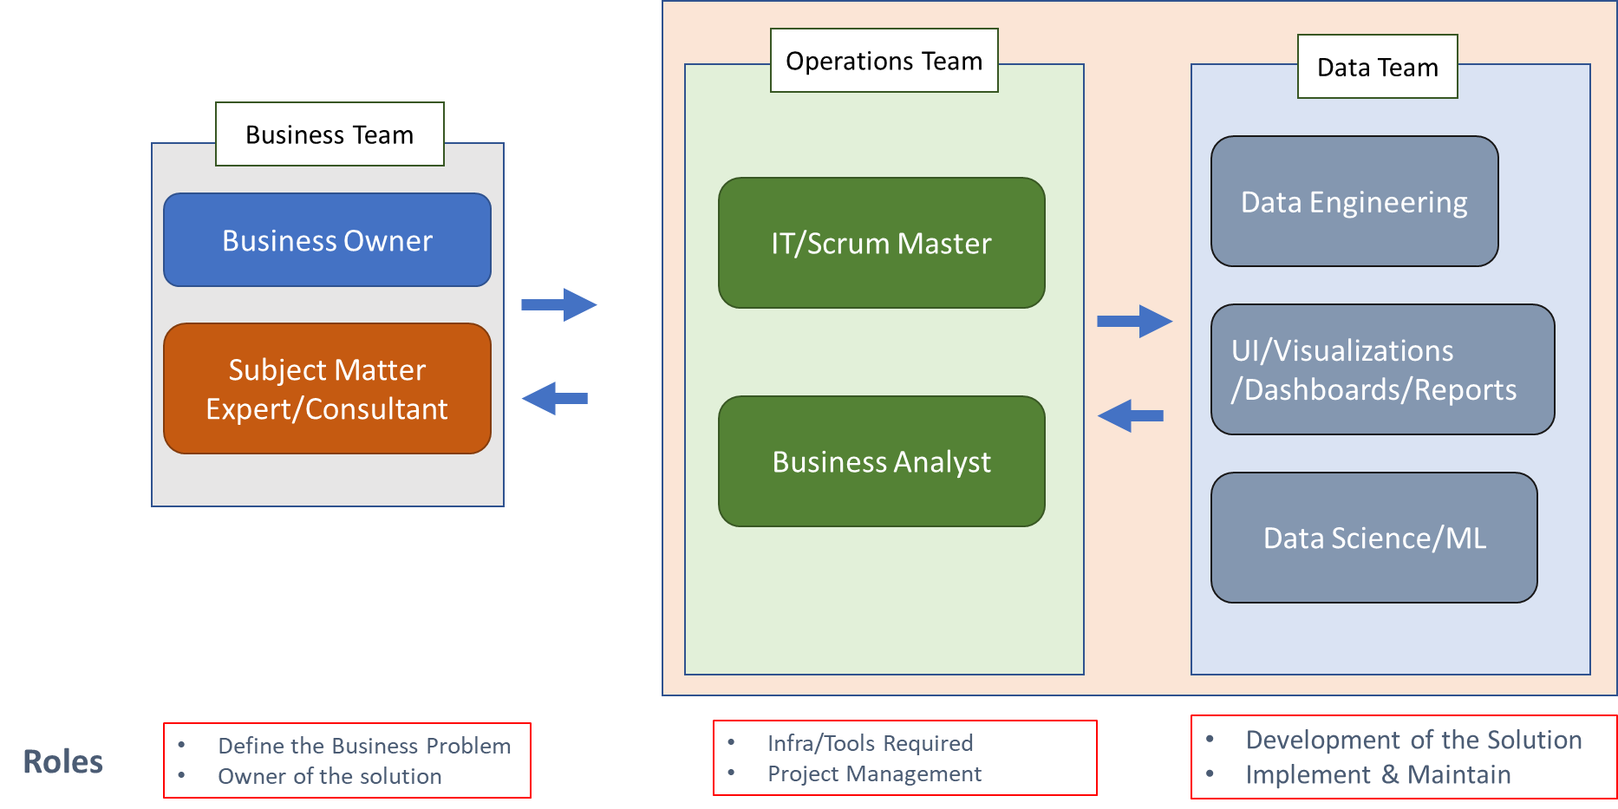
Project Team required for a Data Science project to succeed
Notes:
Tools are good but they are not an alternative to Business Problem and Data not clean

Slide 18
Path/Requirements for a Data Science Project
Business Problem Definition (Precise & Clear)
Getting Data (single biggest challenge mostly)
Data Cleaning (Data is always dirty)
Modelling (various algorithms/cut-offs)
Implementation (put the solution in production)
Maintenance/recalibrate (refresh and maintain)
Step 1
Step 2
Step 3
Step 4
Step 5
Step 6
Notes:
Data Engineering is required for dirty
Call out maintenance and calibration
Success definition, KPI we want to achieve, (business problem is the core

Slide 19
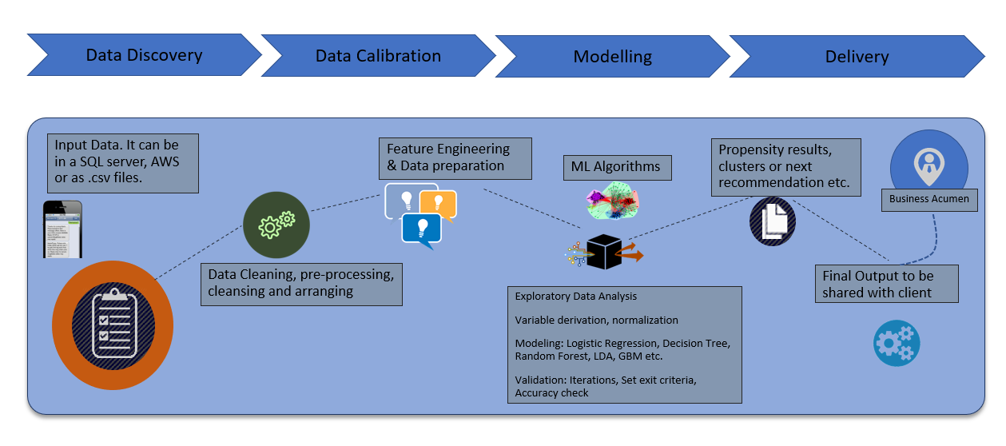
Process for a Machine Learning Model
70% of the time goes to Data Discovery and Data Preparation phase alone
25%
45%
20%
10%

Slide 20
Agenda for the Discussion
Data is the Key
DS/ML/AI
A Typical
DS Project
Tools &
Technology
Q & A

Slide 21
Tools & Technology Stack
Data Engineering: Spark, Hadoop, Spark, SQL, Redshift, Kafka, Java, C++
Data Analysis: Excel, SQL, postgres, mySQL, noSQL, R, Python
Machine Learning: SAS, R, Python, Weka, SPSS, Julia
Visualizations: Tableau, Power BI, Cognos, Qlik
Cloud Services: Microsoft Azure, Amazon Web Services, Google Cloud Platform
Notes:
Tools are good but they are not an alternative to Business Problem and Data not clean

Slide 22






Use cases across industries
BFSI
Retail
Telecom
Credit Card Fraud Detection
Cross-sell/up-sell product and services
Improve Customer Retention and increase the Customer Life Time Value
Use AI for Voice detection, signature matching etc.
Customer Segmentation for better targeting
Pricing model for intelligent pricing
Supply chain optimization
Cross-sell and up-sell models to increase the revenue
Improve customer CLTV
Customer Segmentation for better targeting
Pricing model for intelligent pricing
Supply chain optimization
Cross-sell and up-sell models to increase the revenue
Improve customer CLTV
Aviation
Manufacturing
Energy/Utilities
Improve Customer experience
Optimize the work force
Recommend next best products for the customer
Improve Customer Retention and increase the Customer Life Time Value
Predictive Maintenance for the tools and machines
Demand Forecasting
Inventory Management
Using Artificial Intelligence for Text/ Audio/ Image/ Video Analytics
Customer Segmentation for better targeting
Pricing model for intelligent pricing
Demand Forecasting
Recommendations model
Images: Taken from the Internet

Slide 23
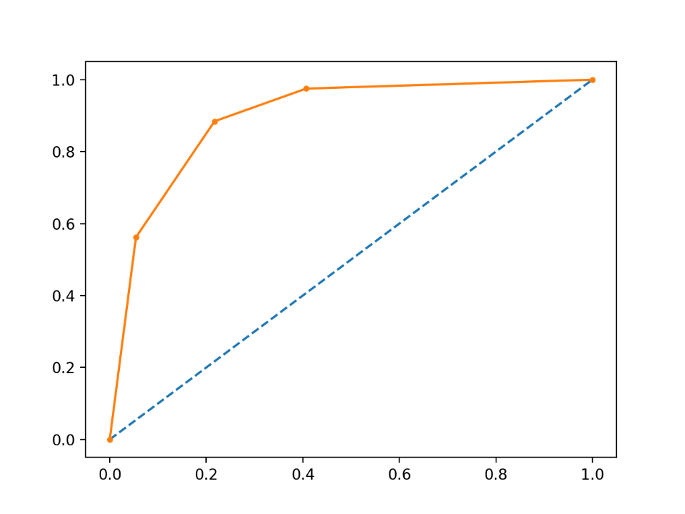
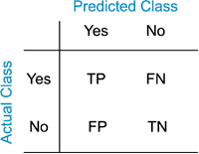
Measure the accuracy for a Data Science Product
Confusion Matrix
ROC Curve
Sometimes, the output will be consumed in a Dashboard. Sometimes, we use the insights to drive our decisions.
Hence, the impact on the business (revenue/cost/output/optimized parameter) has to be measured and monitored regularly.
Image Source: internet

Slide 24
Key Takeaways
Data Science, ML, AI cannot replace the Domain Knowledge
Define and scope the Business Problem well. It decides your success
Keep the goal measurable, achievable and scoped well
Quantity & Quality of Data is the next most important thing
Business Owners have to be involved in the Project from Day 1

Slide 25
What are the Technical Best Practices for an ML/AI project

Slide 26
Getting the Raw Data
The raw data should be randomly collected with no bias of time or performance.
In our case, scope of the problem statement might define the Product, Manufacturing Line, parameters to be selected etc.
For the algorithm to converge and generalize, we should avoid the time periods when there was a change being done on the line or a product was undergoing any transformations/updates.
Ideally a period of 2-3 years should be selected to include cyclicity and seasonality in the data

Slide 27
Training, Testing and Validation Data Set
The test, train and validation data set can be split into 60:20:20 ratio
But if the number of raw data (for example images) are quite high (1million), Andrew Ng suggests to have 98% train, 1% test and 1% validation dataset
All the 3 datasets though, always should be randomly sampled from the original raw data with no bias in selection
The training dataset will be used for training the algorithm
The testing dataset will be used to compare the testing accuracy and overcome Bias-Variance tradeoff
The validation dataset should be exposed to the algorithm only once and after we have finalized the network/algorithm and are done with Hyperparameters tuning

Slide 28
Measures of accuracy
Classification Accuracy = Number of Correct Predictions/Total Observations
Confusion Matrix for Training, Testing datasets. It should be done for each of the subsequent algorithms and iteration done by tuning the Hypermeters
Precision and Recall are a bi-product of the Confusion Matrix. True Positives, True Negatives, False Positives and False Negatives are also generated. Precision measures: out of all the observations classified as Positive, how many are actually positive. Recall measures: out of all the actual Positive cases, how many we were able to capture
AUC values and ROC curves for the above mentioned iterations
F1 score which is a Harmonic Mean of Precision and Recall. The higher it is the better the model is.
Sometimes, Mean Absolute Error and Mean Squared Error are also calculated
Test, test and test your solution vigorously
Testing should be done on out-of-time dataset too

Slide 29
Practical Measures to be considered
Many times, we do test multiple solutions using SAS, MATLAB, Python, R, Weka etc.
To arrive at the best solution suite, we should consider following parameters too:
Ease of Deployment: how easy it is to deploy the model in the production environment
Scalability: is the solution scalable to other products and environment
Maintenance and Model Refresh: ease of maintaining and refresh the model regularly
Speed: of making the predictions. Sometimes, the requirement is in real-time
Cost (licence and man hours required): what is the licence cost and efforts required
Support Available: What type of support is available with us from the team. For example, MATLAB team will be extending support whereas Python will not have such a support system

Slide 30
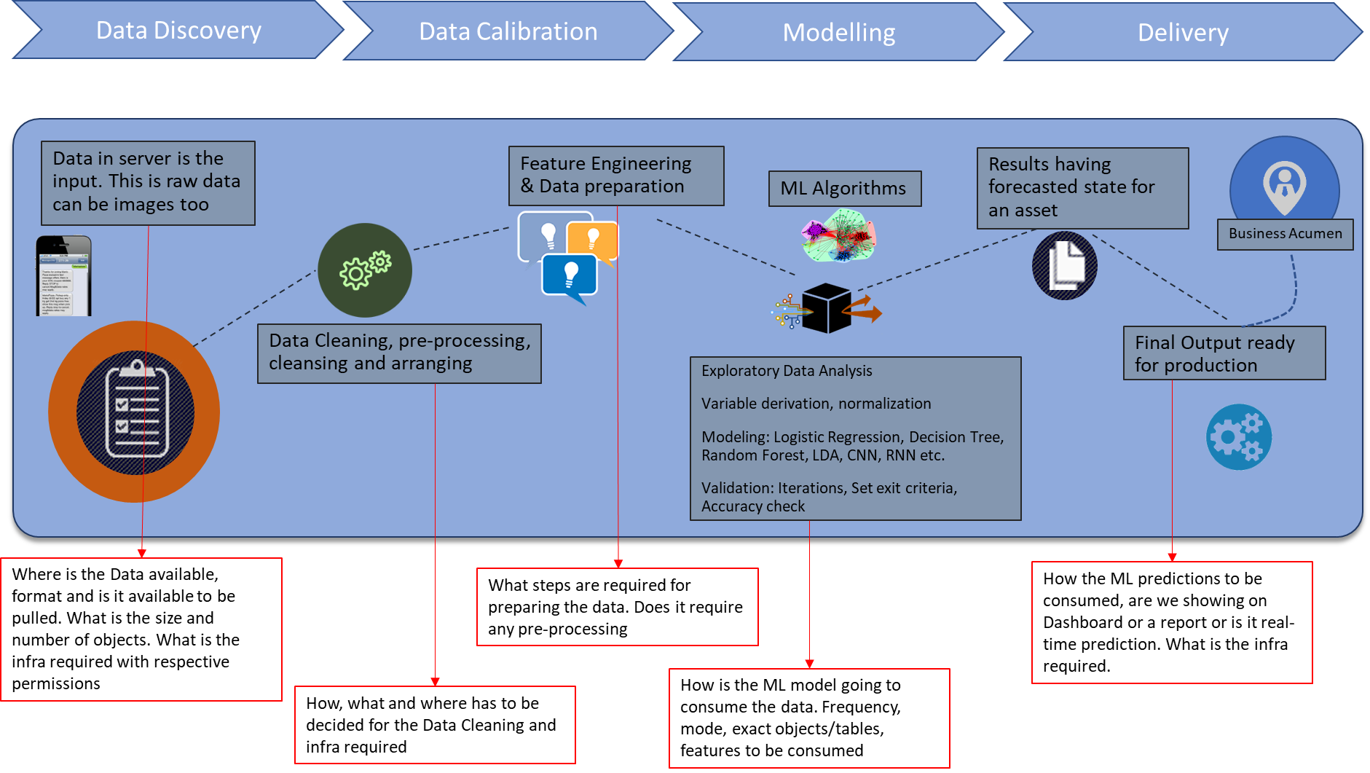
Questions to be considered for ML/solution

Slide 31
Questions please…

Slide 32
Thanks!

